Slide 1
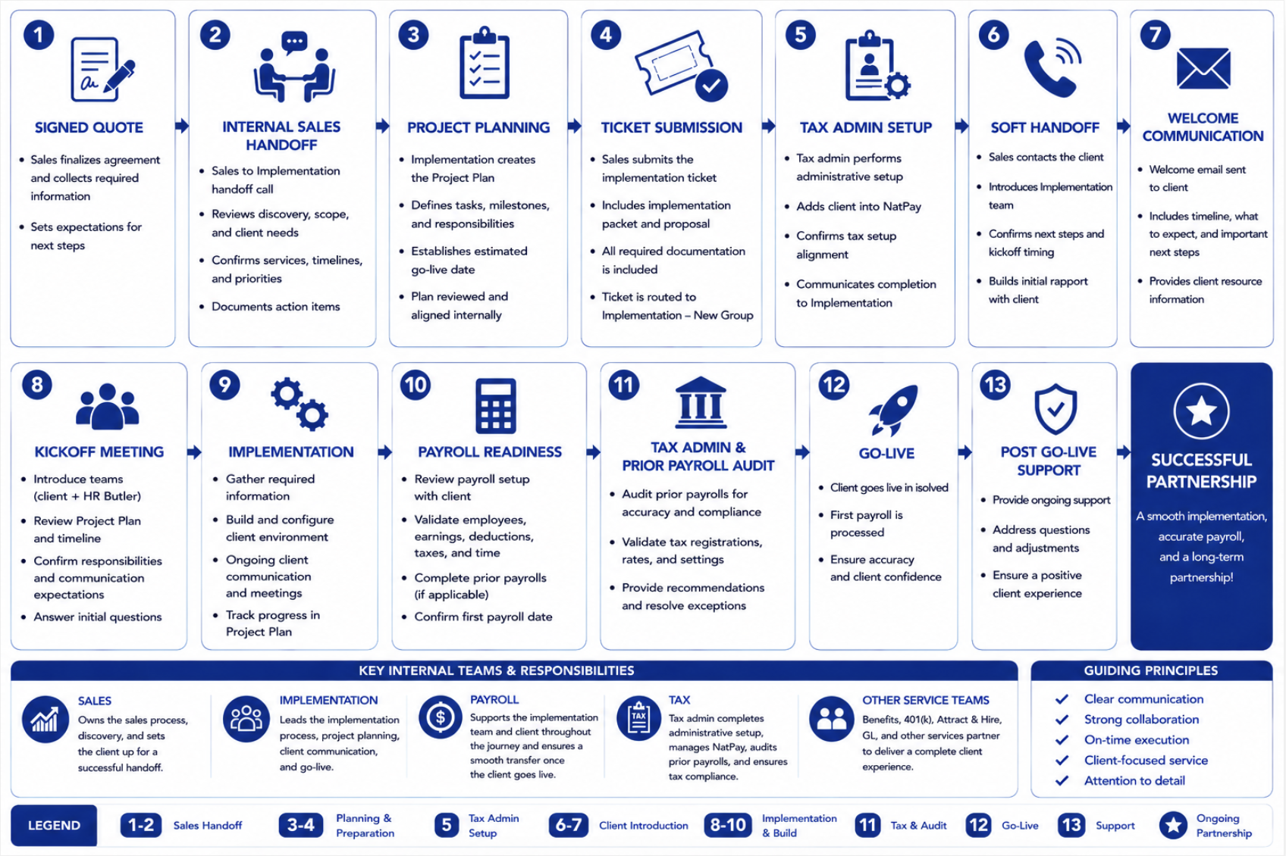
HR Butler Implementation Process Flow Chart
Our goal is a smooth, efficient implementation and successful go-live.

